Slide 1

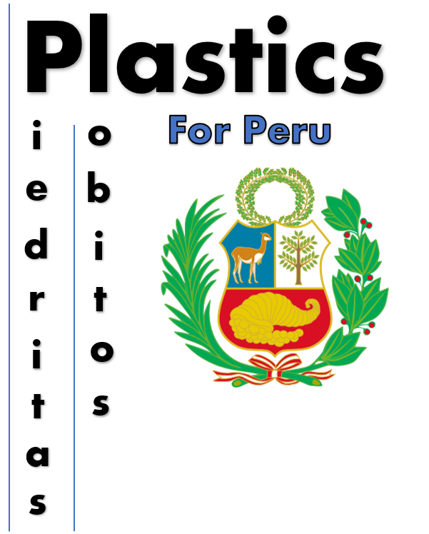

Engineers Without Borders 2021 Lobitos & Piedritas UK2021-048 – Plastics for Peru
Ross Brown, Cameron Maxwell, Andrew Leahy, Callum Jardine, Chi Hang Tse, and Zeon Ojouko.

Slide 2
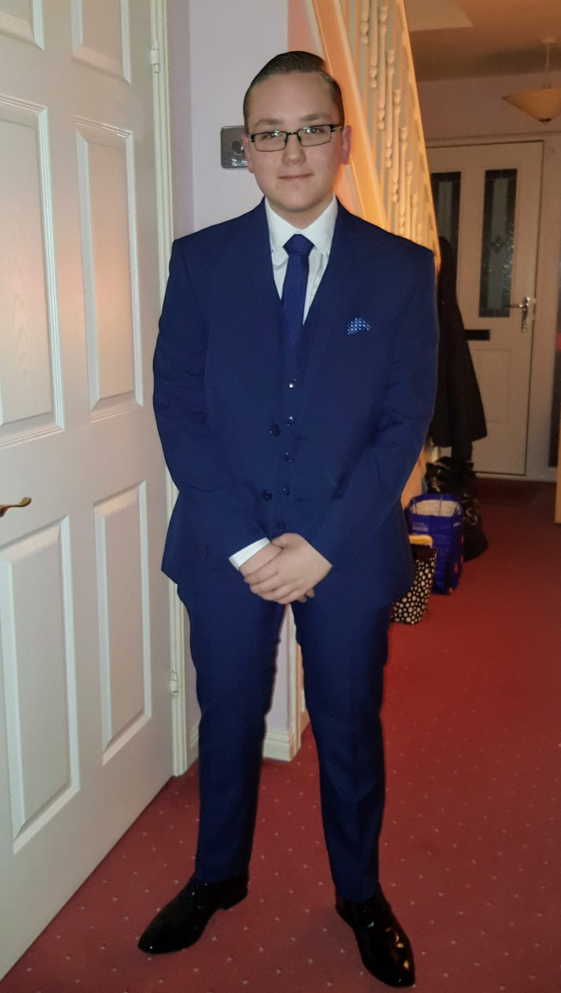
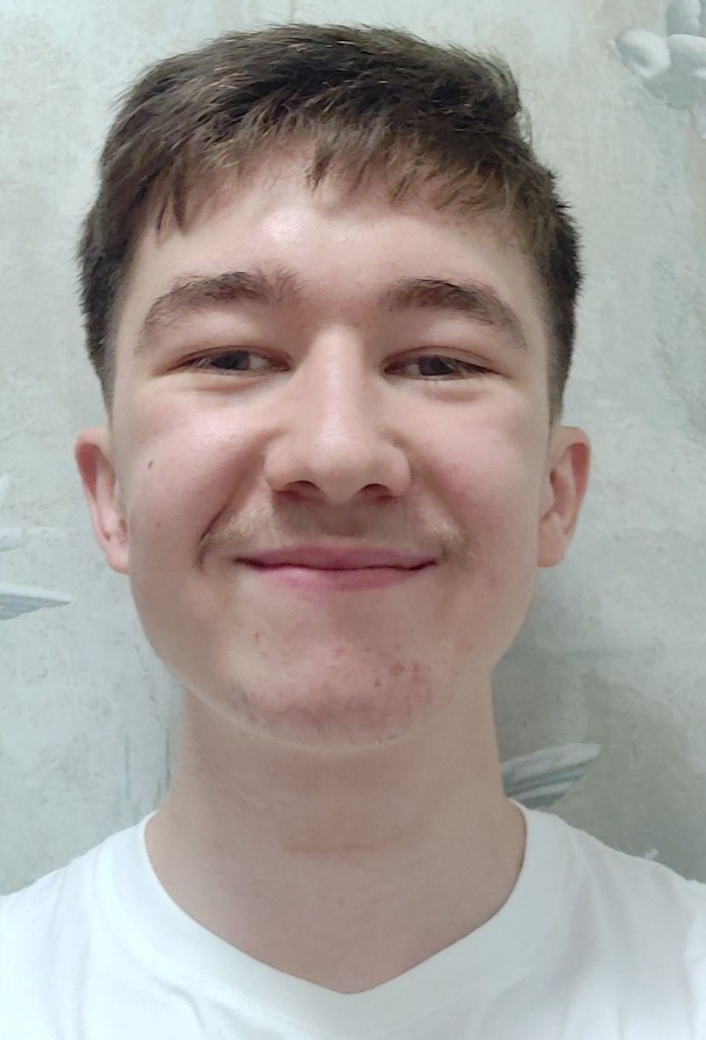
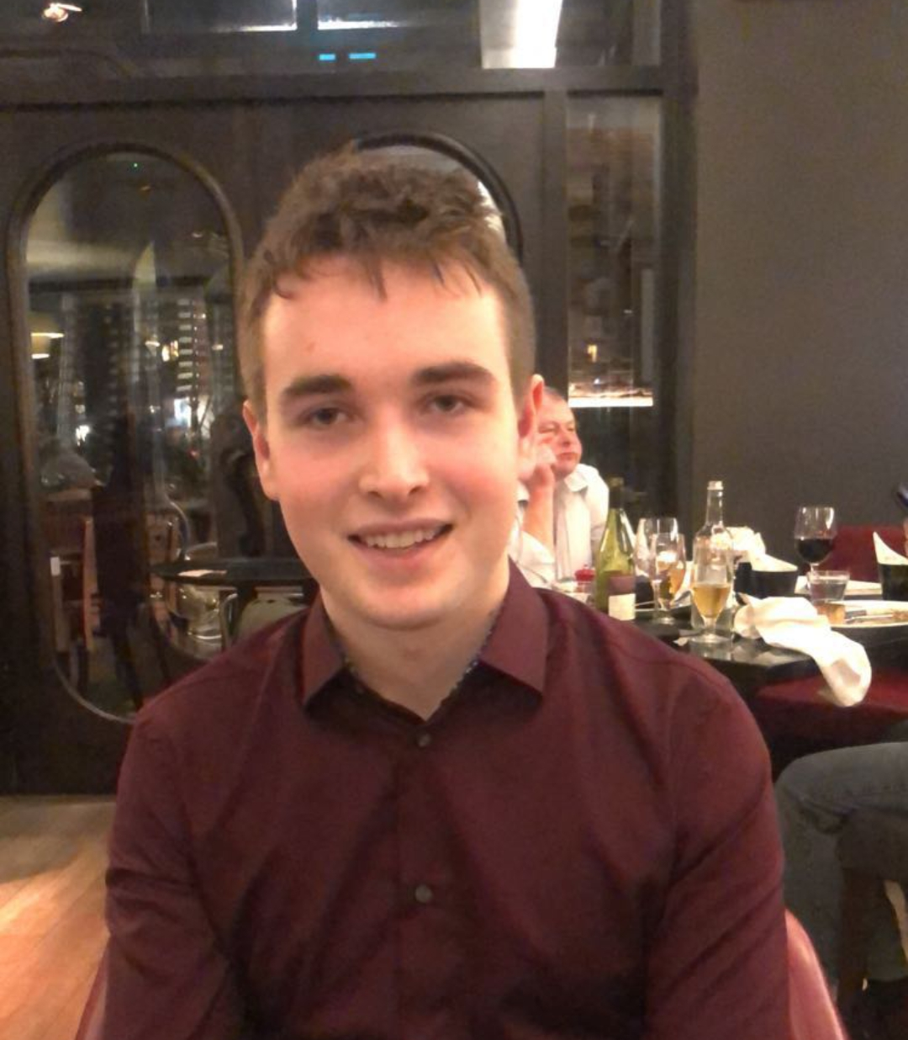
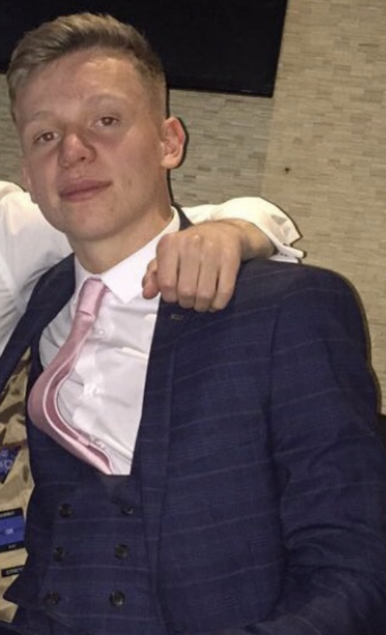
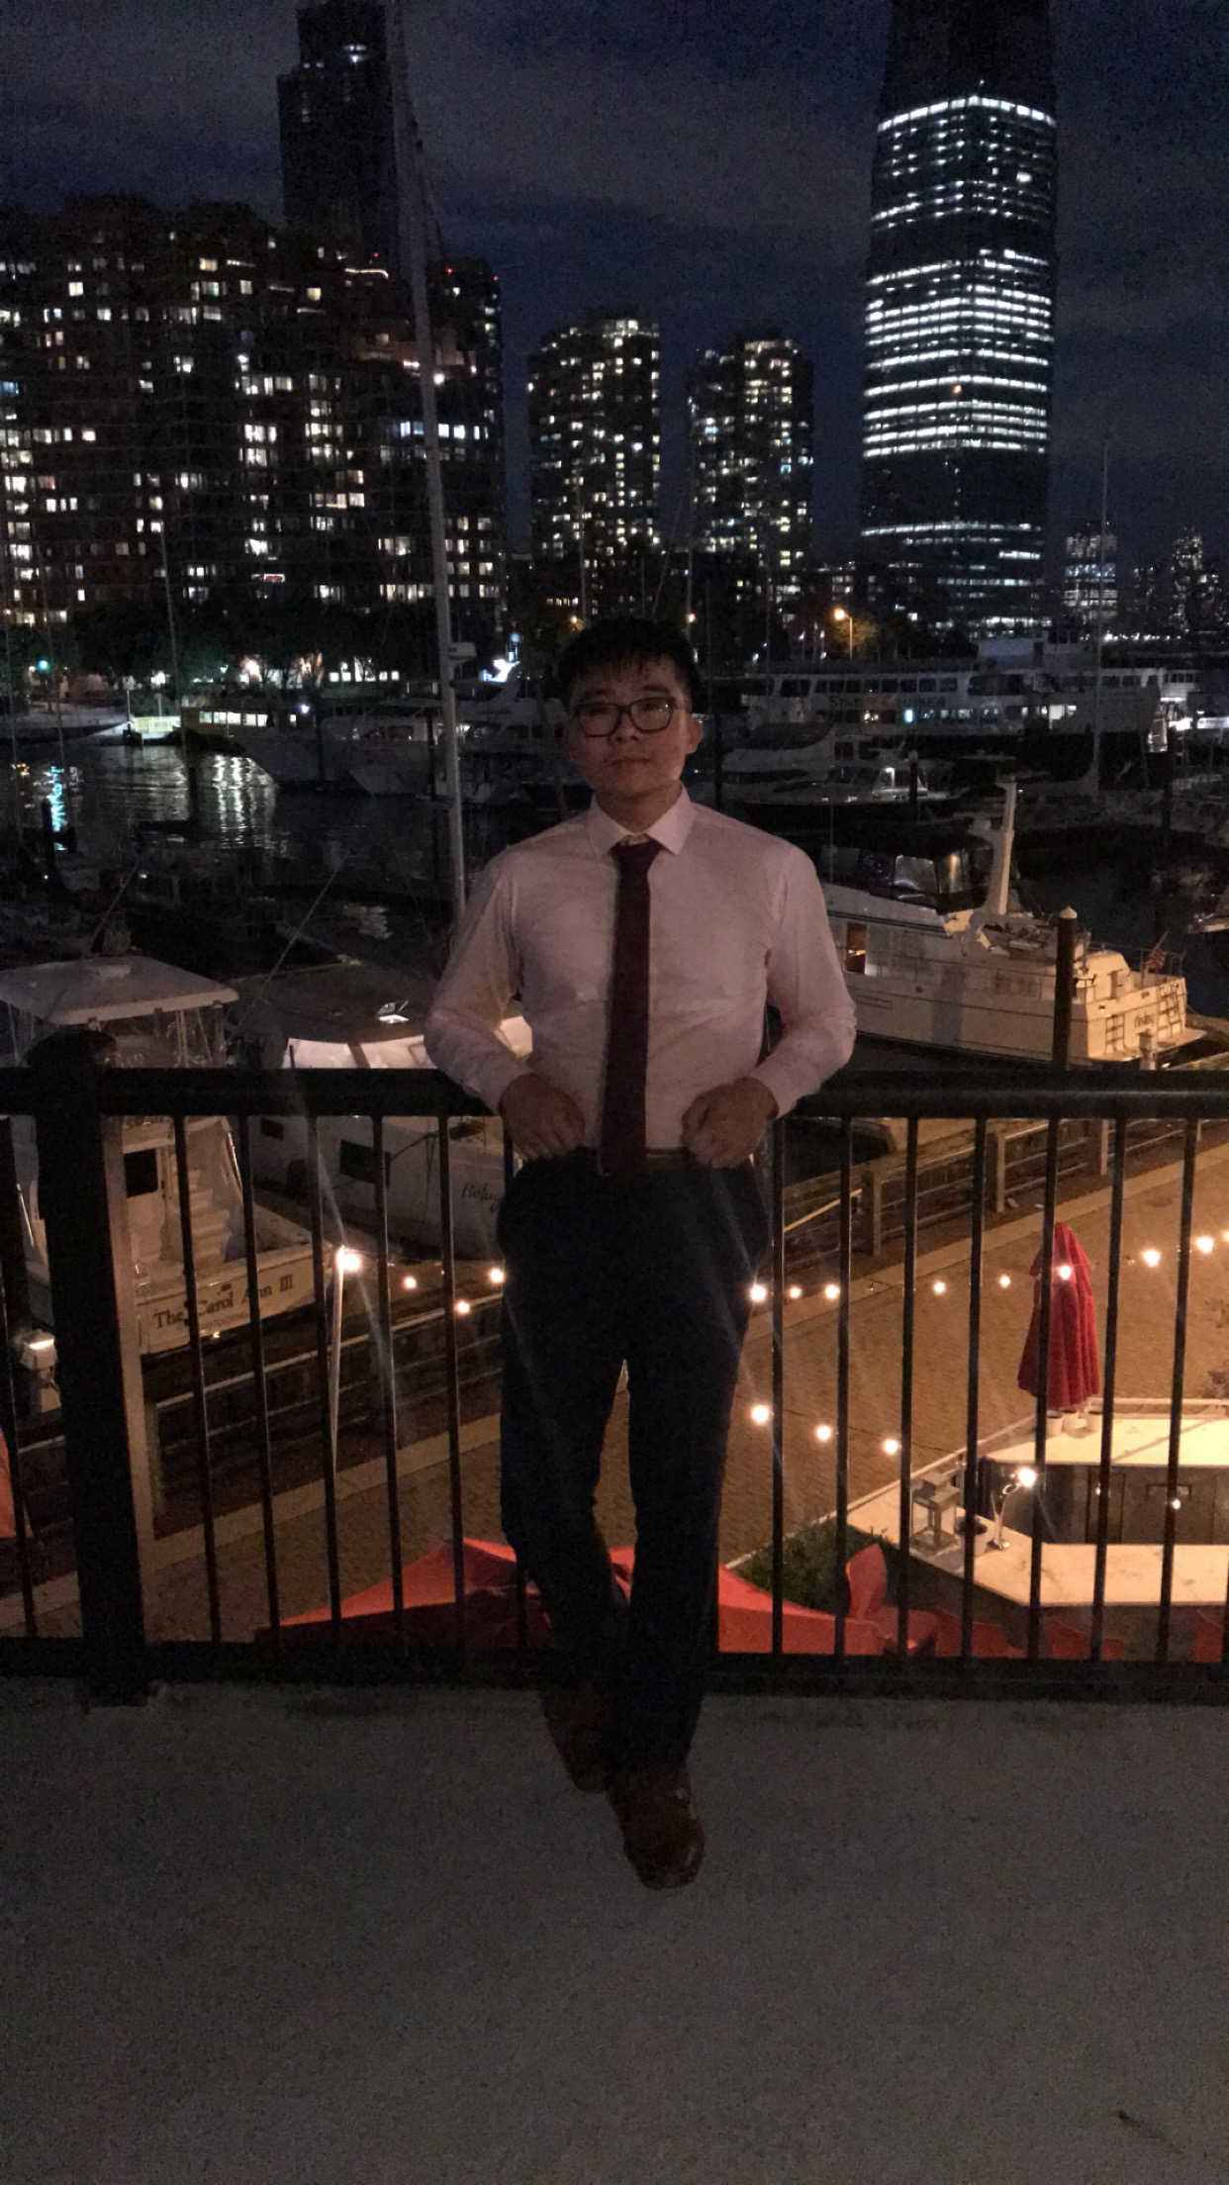

The Team
Ross Brown
Mechanical Engineering
(H00298706)
Cameron Maxwell
Chemical Engineering
(H00297067)
Andrew Leahy
Mechanical Engineering
(H00299134)
Callum Jardine
Electrical Engineering
(H00322038)
Chi Hang Tse
Mechanical Engineering
(H00298823)
Zeon Ojuoko
Robotics, Autonomous and interactive systems
(H00298128)

Slide 3

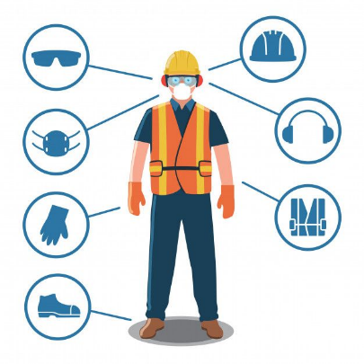
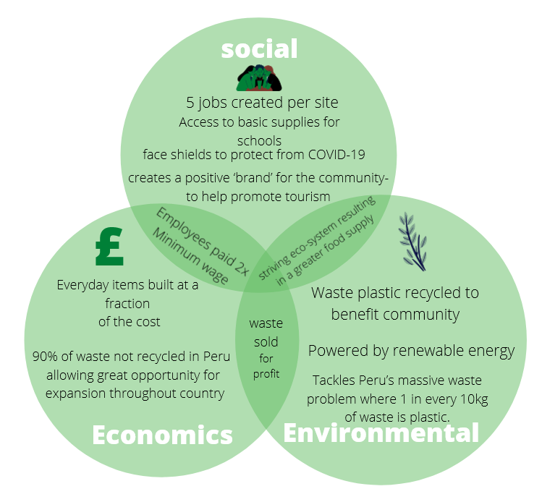





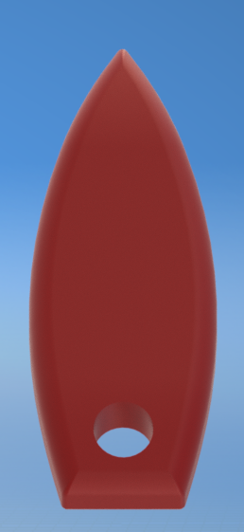
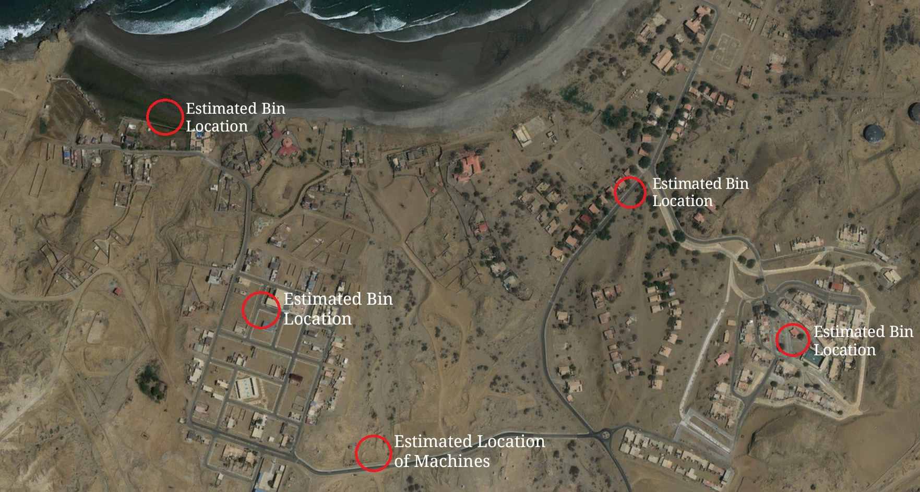

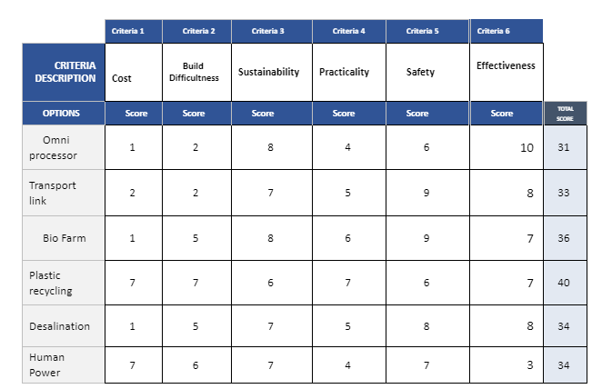


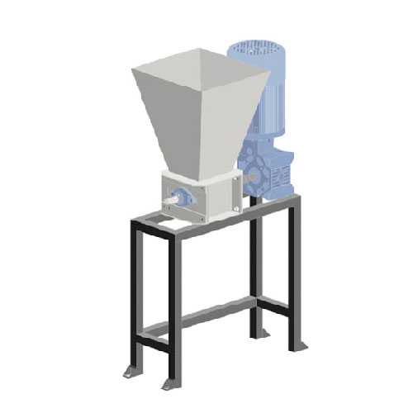
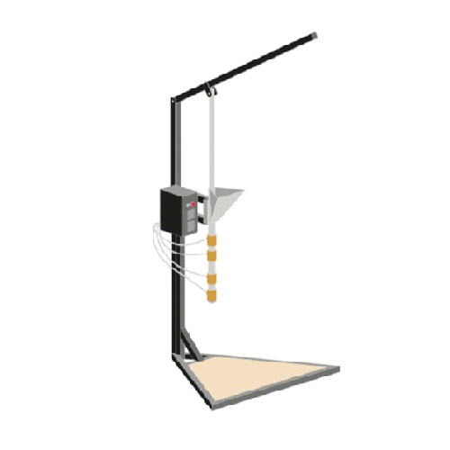
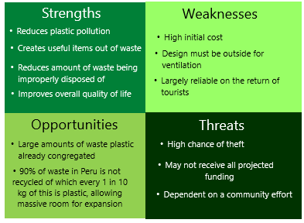
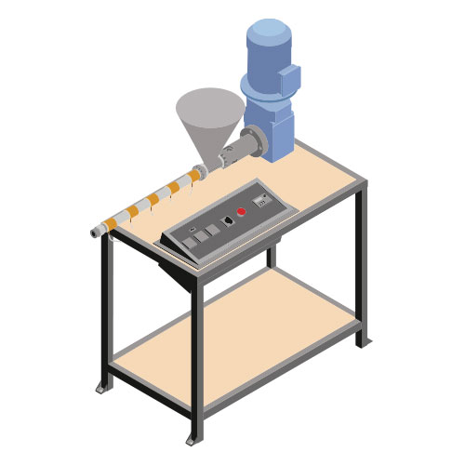
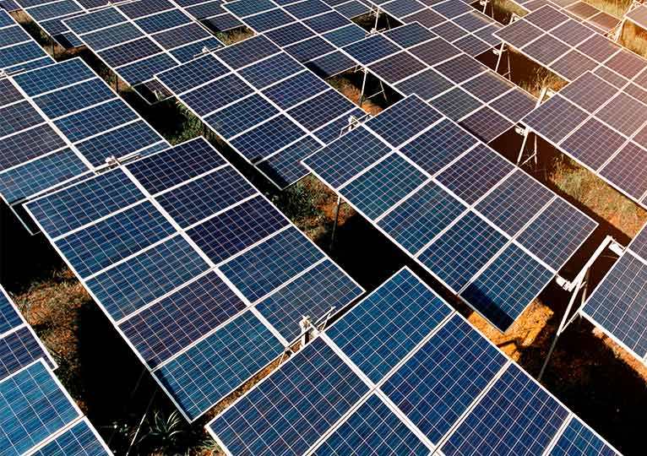
Sustainable Plastic Recycling
8. Sustainability
9. Risk and Safety
UK2021-048
Ross Brown Cameron Maxwell Andrew Leahy
Callum Jardine Chi Hang Tse Zeon Ojouko
By Plastics For Peru
1. About Us
5. Processes
Despite good amounts of tourism in the area the communities of Lobitos and Piedritas struggle from high levels of poverty. This is partly because much of the money generated from this tourism goes to foreign investors instead.
In order to improve the quality of life of people in the region we plan to recycle their plastic waste into several solutions which can be used to help the community and several items which can be sold to tourists, generating capital which can then be reinvested into our project and allowing the local community to benefit more from the tourism industry.
As plastic is so versatile it can be used to address a range of issues the communities faces from rainwater collection to school supplies. Our project also allows new solutions to be created as new issues come up.
Waste is collected from three key areas:
The towns
The local dumpsite
The beach
The plastic can also be Imported from other areas of Peru if the supply was too low from the local area.
It is then taken to a local collection point.
Here, the plastics are inspected and sorted into the various plastic types.
A mobile collection van can also be used to take the plastic to the recycling centre.
Distanced
Entanglement
Maintenance
Sharp objects
Toxic fumes
10. Map of Lobitos Locations
The recycled plastics will be used to make various items, such as:
face masks
key chains
rulers
The plastics are then received from the collection point.
They are processed into a form where they can be reused.
2. Design Matrix
6. Machines
Generating items from waste plastic involves 3 steps.
Shredding of the plastic into smaller parts.
Melting the shredded plastic.
Pumping the melted plastic into a mould and letting it set.
The Shredder
11. Economics
The 3 Machines
The Shredder – Breaks larger plastic objects down into small parts, easier and more consistent to melt
The Injection Moulder – Both melts the plastic and moulds it, producing more intricate 3D items.
The Extruder – Melts the plastic and moulds to produce a beam of specified shape, can be 2D, or 3D.
3. SWOT Analysis
The Injection Moulder
The Extrusion Machine
7. Energy
A 25kV Hybrid Solar System was chosen based one energy requirements
Peru receives consistent high-intensity sun that provides a valuable source of energy
Hybrid solar system to ensure a constant supply of energy
Costs | GBP | Sol
Solar Panels | £19,810.97 | S/ 94,819.09
Fencing | £5,744.15 | S/ 27,492.60
Salaries | £12,102.24 | S/ 57,508.86
Machines | £4,333.22 | S/ 20,739.62
Molds (stage 1 - 3) | £3,389.82 | S/ 16,224.33
Collection Points | £1,439.65 | S/ 6,890.44
Shipping (estimate) | £15,000.00 | S/ 47,519.19
Misc | £3,415.00 | S/ 1,995.53
Total | £65,235.05 | S/ 239,143.86
4. Long Term Plan
Stage 0
- Source Funding for the project
Assemble and ship the required goods
Acquire land and develop the facility
Begin a training scheme for unemployed locals
Stage 1
Place Recycling collection points & collect all available recycled plastics
Begin production on face shields & classroom supplies
Distribute items amongst Lobitos & Piedritas
Measure success at this stage, can we progress?
Stage 2
Diversify our production, making water bottles, keyrings and recycling bins.
Sell keyrings to tourists, recycling all money earned back into production.
Stage 3, 4 and 5
Through measuring the success of the previous stage, upscale production in order to make both, more, and larger items.
Increase the amount of machinery and solar panels in order to sustain a healthy manufacturing process.

Slide 4
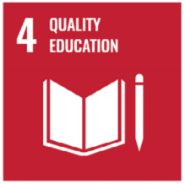
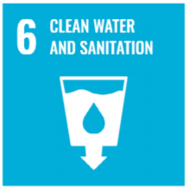
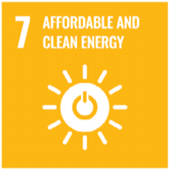
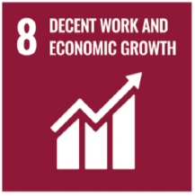
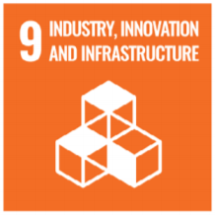
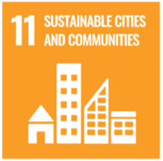
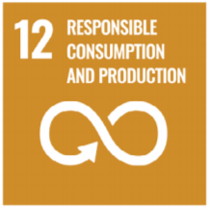
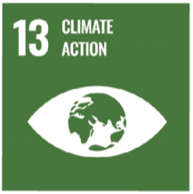
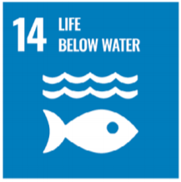
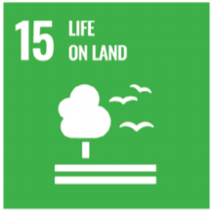
About Us
Despite good amounts of tourism in the area the communities of Lobitos and Piedritas struggle from high levels of poverty. This is partly because much of the money generated from this tourism goes to foreign investors instead.
In order to improve the quality of life of people in the region we plan to recycle their plastic waste into several solutions which can be used to help the community and several items which can be sold to tourists, generating capital which can then be reinvested into our project and allowing the local community to benefit more from the tourism industry.
As plastic is so versatile it can be used to address a range of issues the communities faces from rainwater collection to school supplies. Our project also allows new solutions to be created as new issues come up.
Andrew Leahy

Slide 5
Design Matrix
Zeon Ojuoko

Slide 6
SWOT Analysis
Strengths
Weaknesses
Reduces plastic pollution
High initial cost
Creates useful items out of waste
Design must be outside for ventilation
Reduces amount of waste being improperly disposed of
Largely reliable on the return of tourists
Improves overall quality of life
Opportunities
Threats
Large amounts of waste plastic already congregated
High chance of theft
90% of waste in Peru is not recycled of which every 1 in 10 kg of this is plastic, allowing massive room for expansion
May not receive all projected funding
Dependent on a community effort
Callum Jardine

Slide 7

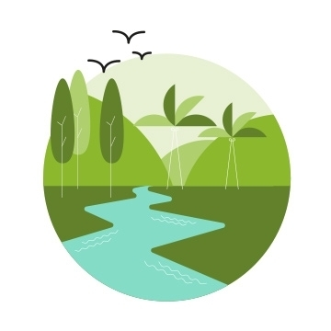
Long Term Plan
Stage 0
- Source Funding for the project
Assemble and ship the required goods
Acquire land and develop the facility, 250m².
Begin a training scheme for unemployed locals
Stage 1
Place Recycling collection points & collect all available recycled plastics
Begin production on face shields & classroom supplies
Distribute items amongst Lobitos & Piedritas
Measure success at this stage, can we progress?
Stage 2
Diversify our production, making water bottles, keyrings and recycling bins.
Sell keyrings to tourists, all money we have earned back into the production of more items.
Stages 3, 4 and 5
Through measuring the success of the previous stage, upscale production in order to make both, more, and larger items.
Increase the amount of machinery and solar panels in order to sustain a healthy manufacturing process.
Cameron Maxwell

Slide 8
Processes
Waste is collected from three key areas:
The towns
The local dumpsite
The beach
The plastic can also be Imported from other areas of Peru if the supply was too low from the local area.
It is then taken to the collection point.
Here, the plastics are inspected and sorted into the various plastic types.
A mobile collection van can also be used to take the plastic to the recycling centre.
The recycled plastics will be used to make various items, such as:
face masks
key chains
rulers
The plastics are then received from the collection point.
They are processed into a form where they can be reused.
Ross Brown

Slide 9
Machines
Generating items from waste plastic involves 3 steps.
Shredding of the plastic into smaller parts.
Melting the shredded plastic.
Pumping the melted plastic into a mould and letting it set.
The Shredder
The 3 Machines
The Shredder – Breaks larger plastic objects down into small parts, easier and more consistent to melt
The Injection Moulder –
The Extruder– Melts the plastic and moulds to produce a beam of specified shape, can be 2D, or 3D.
The Injection Moulder
The Extrusion Machine
Cameron Maxwell

Slide 10
Energy
A 25kV Hybrid Solar System
A 25kV Hybrid Solar System was chosen based one energy requirements
Peru receives consistent high-intensity sun that provides a valuable source of energy
Hybrid solar system to ensure a constant supply of energy
Zeon Ojuoko

Slide 11
Sustainability
Callum Jardine

Slide 12
Risk and Safety
Machines Health and Safety
Distanced
Entanglement
Maintenance
Sharp objects
Toxic fumes
Fully trained by experts
Water proof
Outdoor facility
Chi Hang Tse

Slide 13

Mapping the Locations
Plastics
i
o
For Peru
e
b
d
i
r
t
i
o
t
s
a
s
Andrew Leahy

Slide 14



Economics
Costs | GBP | Sol
Solar Panels | £19,810.97 | S/ 94,819.09
Fencing | £5,744.15 | S/ 27,492.60
Salaries | £12,102.24 | S/ 57,508.86
Machines | £4,333.22 | S/ 20,739.62
Molds (stage 1 - 3) | £3,389.82 | S/ 16,224.33
Collection Points | £1,439.65 | S/ 6,890.44
Shipping (estimate) | £15,000.00 | S/ 47,519.19
Misc | £3,415.00 | S/ 1,995.53
Total | £65,235.05 | S/ 239,143.86
Ross Brown

Slide 15
Sustainable Plastic Recycling
8. Sustainability
9. Risk and Safety
Group 27
Ross Brown Cameron Maxwell Andrew Leahy
Callum Jardine Chi Hang Tse Zeon Ojouko
By Plastics For Peru
1. About Us
5. Processes
Despite good amounts of tourism in the area the communities of Lobitos and Piedritas struggle from high levels of poverty. This is partly because much of the money generated from this tourism goes to foreign investors instead.
In order to improve the quality of life of people in the region we plan to recycle their plastic waste into several solutions which can be used to help the community and several items which can be sold to tourists, generating capital which can then be reinvested into our project and allowing the local community to benefit more from the tourism industry.
As plastic is so versatile it can be used to address a range of issues the communities faces from rainwater collection to school supplies. Our project also allows new solutions to be created as new issues come up.
Waste is collected from three key areas:
The towns
The local dumpsite
The beach
The plastic can also be Imported from other areas of Peru if the supply was too low from the local area.
It is then taken to a local collection point.
Here, the plastics are inspected and sorted into the various plastic types.
A mobile collection van can also be used to take the plastic to the recycling centre.
Distanced
Entanglement
Maintenance
Sharp objects
Toxic fumes
10. Map of Lobitos Locations
The recycled plastics will be used to make various items, such as:
face masks
key chains
rulers
The plastics are then received from the collection point.
They are processed into a form where they can be reused.
2. Design Matrix
6. Machines
Generating items from waste plastic involves 3 steps.
Shredding of the plastic into smaller parts.
Melting the shredded plastic.
Pumping the melted plastic into a mould and letting it set.
The Shredder
11. Economics
The 3 Machines
The Shredder – Breaks larger plastic objects down into small parts, easier and more consistent to melt
The Injection Moulder – Both melts the plastic and moulds it, producing more intricate 3D items.
The Extruder – Melts the plastic and moulds to produce a beam of specified shape, can be 2D, or 3D.
3. SWOT Analysis
The Injection Moulder
The Extrusion Machine
7. Energy
A 25kV Hybrid Solar System was chosen based one energy requirements
Peru receives consistent high-intensity sun that provides a valuable source of energy
Hybrid solar system to ensure a constant supply of energy
Costs | GBP | Sol
Solar Panels | £19,810.97 | S/ 94,819.09
Fencing | £5,744.15 | S/ 27,492.60
Salaries | £12,102.24 | S/ 57,508.86
Machines | £4,333.22 | S/ 20,739.62
Molds (stage 1 - 3) | £3,389.82 | S/ 16,224.33
Collection Points | £1,439.65 | S/ 6,890.44
Shipping (estimate) | £15,000.00 | S/ 47,519.19
Misc | £3,415.00 | S/ 1,995.53
Total | £65,235.05 | S/ 239,143.86
4. Long Term Plan
Stage 0
- Source Funding for the project
Assemble and ship the required goods
Acquire land and develop the facility
Begin a training scheme for unemployed locals
Stage 1
Place Recycling collection points & collect all available recycled plastics
Begin production on face shields & classroom supplies
Distribute items amongst Lobitos & Piedritas
Measure success at this stage, can we progress?
Stage 2
Diversify our production, making water bottles, keyrings and recycling bins.
Sell keyrings to tourists, recycling all money earned back into production.
Stage 3, 4 and 5
Through measuring the success of the previous stage, upscale production in order to make both, more, and larger items.
Increase the amount of machinery and solar panels in order to sustain a healthy manufacturing process.

Slide 17

Plastics for Peru
Plastic Waste Recycling
Taking plastic waste around Lobitos and Piedritas and converting it into items that directly benefit both communities. Completed using 100% renewable energy.
Versatility
The machines used to process plastic waste allow a wide array of items to be made that can help counteract the current challenge areas within Lobitos and Piedritas.
Current examples include:
- Face Shields - Classroom Supplies - Souvenirs
- Water Collection Tanks - Recycling Bins - Plastic Bricks (coming soon)
The use of Solar panels to power the project means that even if it fails the solar panels remain and can be used to help provide a reliable power source for the two communities.
The Plastic Shredder
The Injection Moulder
Sustainability
We aim to create items that will encourage tourists to return to the region two current examples are, face shields to help control the spread of COVID-19 and souvenirs made from plastic waste to help generate a new income source for the community.
We aim to get locals directly involved in the project, providing training and opportunities of employment, generating jobs within the area.
Most importantly, this project will listen to the community. Acting upon the direction they believe is best. Taking suggestions at any point within the process.
The Extrusion Moulder
Become as passionate about this project as we are by checking out the PDF, YouTube, and leaving comments below!
All imagery shown above is property of an initiative called Precious Plastics. It has been our goal to take the work they are doing and apply it to a location we feel would greatly benefit from its use. All taken imagery is open source and its intended use is an attempt to help solve the horribly vast amount of plastic pollution that the world currently faces.

Slide 18
Plastics for Peru
Plastic Waste Recycling
Taking plastic waste around Lobitos and Piedritas and converting it into items that directly benefit both communities. Completed using 100% renewable energy.
Versatility
The machines used to process plastic waste allow a wide array of items to be made that can help counteract the current challenge areas within Lobitos and Piedritas.
Current examples include:
- Face Shields - Classroom Supplies - Souvenirs
Water Collection Tanks - Recycling Bins - Plastic Bricks
The use of Solar panels to power the project means that even if it fails the solar panels remain and can be used to help provide a reliable power source for the two communities.
The Plastic Shredder
The Injection Moulder
Sustainability
We aim to create items that will encourage tourists to return to the region two current examples are, face shields to help control the spread of COVID-19 and souvenirs made from plastic waste to help generate a new income source for the community.
We aim to get locals directly involved in the project, providing training and opportunities of employment, generating jobs within the area.
Most importantly, this project will listen to the community. Acting upon the direction they believe is best. Taking suggestions at any point within the process.
The Extrusion Moulder
Find out more about our design by checking out our crowdsolve page here - https://www.efp-uk.crowdsolve.net/workspace

Slide 19

Plastics for Peru
Plastic Waste Recycling
Taking plastic waste around Lobitos and Piedritas and converting it into items that directly benefit both communities. Completed using 100% renewable energy.
Versatility
The machines used to process plastic waste allow a wide array of items to be made that can help counteract the current challenge areas within Lobitos and Piedritas.
Current examples include:
- Face Shields - Classroom Supplies - Souvenirs
- Water Collection Tanks - Recycling Bins - Plastic Bricks (coming soon)
The use of Solar panels to power the project means that even if it fails the solar panels remain and can be used to help provide a reliable power source for the two communities.
The Plastic Shredder
The Injection Moulder
Sustainability
We aim to create items that will encourage tourists to return to the region two current examples are, face shields to help control the spread of COVID-19 and souvenirs made from plastic waste to help generate a new income source for the community.
We aim to get locals directly involved in the project, providing training and opportunities of employment, generating jobs within the area.
Most importantly, this project will listen to the community. Acting upon the direction they believe is best. Taking suggestions at any point within the process.
The Extrusion Moulder
Become as passionate about this project as we are by checking out the PDF, YouTube, and leaving comments below!
All imagery shown above is property of an initiative called Precious Plastics. It has been our goal to take the work they are doing and apply it to a location we feel would greatly benefit from its use. All taken imagery is open source and its intended use is an attempt to help solve the horribly vast amount of plastic pollution that the world currently faces.

Slide 20
Plastics for Peru
Plastic Waste Recycling
Taking plastic waste around Lobitos and Piedritas and converting it into items that directly benefit both communities. Completed using 100% renewable energy.
Versatility
The machines used to process plastic waste allow a wide array of items to be made that can help counteract the current challenge areas within Lobitos and Piedritas.
Current examples include:
- Face Shields - Classroom Supplies - Souvenirs
- Water Collection Tanks - Recycling Bins - Plastic Bricks (coming soon)
The use of Solar panels to power the project means that even if it fails the solar panels remain and can be used to help provide a reliable power source for the two communities.
The Plastic Shredder
The Injection Moulder
Sustainability
We aim to create items that will encourage tourists to return to the region two current examples are, face shields to help control the spread of COVID-19 and souvenirs made from plastic waste to help generate a new income source for the community.
We aim to get locals directly involved in the project, providing training and opportunities of employment, generating jobs within the area.
Most importantly, this project will listen to the community. Acting upon the direction they believe is best. Taking suggestions at any point within the process.
The Extrusion Moulder
Become as passionate about this project as we are by checking out the PDF, YouTube, and leaving comments below!
All imagery shown above is property of an initiative called Precious Plastics. It has been our goal to take the work they are doing and apply it to a location we feel would greatly benefit from its use. All taken imagery is open source and its intended use is an attempt to help solve the horribly vast amount of plastic pollution that the world currently faces.

Slide 21
Plastics for Peru
Plastic Waste Recycling
Taking plastic waste around Lobitos and Piedritas and converting it into items that directly benefit both communities. Completed using 100% renewable energy.
Versatility –
The machines used to process plastic waste allow an endless number of items to be made that can help the community. The only limit is the imagination.
Current examples include:
Face Shields - Classroom Supplies
Water Collection Tanks - Recycling Bins
The Plastic Shredder
Sustainability -
Through creating items that help to rejuvenate the tourism within the region the machines can be used to create souvenirs to help fund further projects in the area.
We aim to create items that will encourage tourists to return to the region e.g., face shields to help control the spread of COVID-19, souvenirs made from plastic waste to help generate a new income source for the community, and recycling bins to allow all locations throughout the communities to look their best, plastic free, self's.
The project prioritises creating items that will rejuvenate the tourism within the region.
Employing Locals
Energy Production
The Injection Moulder
Potential -
Excessive plastic waste
Expansion into other regions
Bigger ther production the better the items that can be made, and the better the cost efficiency.
The project can be left in the hands of the locals.
The Extrusion Moulder
Become as passionate about this project as we are by checking out the PDF and YouTube video shown below!

Slide 22
Plastics for Peru
Plastic Waste Recycling
Taking plastic waste around Lobitos and Piedritas and converting it into items that directly benefit both communities. Completed using 100% renewable energy.
Versatility
The machines used to process plastic waste allow a wide array of items to be made that can help counteract the current challenge areas within Lobitos and Piedritas.
Current examples include:
Face Shields - Classroom Supplies - Souvenirs
Water Collection Tanks - Recycling Bins - Plastic Bricks (coming soon)
- The use of Solar panels to power the project means that even if it fails the solar panels remain and can be used to help provide a reliable power source for the two communities.
The Plastic Shredder
Sustainability -
The project prioritises creating items that will rejuvenate the tourism within the region.
Employing Locals
Energy Production
The Injection Moulder
Potential -
Excessive plastic waste
Expansion into other regions
Bigger ther production the better the items that can be made, and the better the cost efficiency.
The project can be left in the hands of the locals.
The Extrusion Moulder
Become as passionate about this project as we are by checking out the PDF and YouTube video shown below!
All imagery shown above is property of an initiative called Precious Plastics. It has been our goal to take the work they are doing and apply it to a location we feel would greatly benefit from its use. All taken imagery is open source and its intended use is an attempt to help solve the horribly vast amount of plastic pollution that the world currently faces.

Slide 23
Summary:
Plastic waste is a worldwide issue, spoiling beaches, harming wildlife, and its current recycling schemes taking a toll on the environment. Lobitos and Piedritas are currently no different, but our goal is to tackle this whilst using the same plastic to help the community in a number of ways.
Our design tackles this plastic waste issue, using several machines to recycle the usable plastics into various items. These items are then to be used to tackle a variety of other problem areas facing the communities, examples include, rainwater collection tanks to provide a clean and reliable water source; classroom supplies to help improve the quality of education, face shields to help prevent the spread of COVID-19, and many more. The machines will be powered by a solar array which will feed the additional power it generates into the local grid, helping with the, currently unreliable, grid stability. The size of the project is easily scalable, and the project easily adaptable to problems that may face the communities in the coming future.
We encourage you to have a look at the resources we have provided below, we truly believe in this project and really hope that by learning about it, you can too! We'd be really excited to respond to any comments you leave about your thoughts and ideas, we are very open-minded and happy to take any ideas onboard.

